Slide 1
Building Microsoft Graph applications
Build a JavaScript application using Microsoft Graph

Slide 2

Build a JavaScript application using Microsoft Graph
Application registration
Obtaining packages
Application experience
Overview of the sample

Slide 3
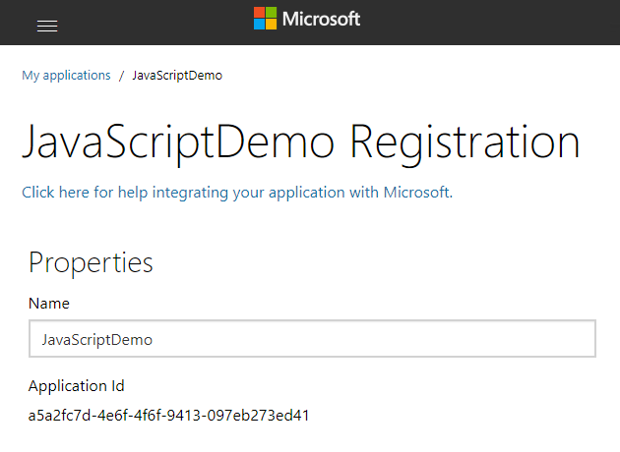
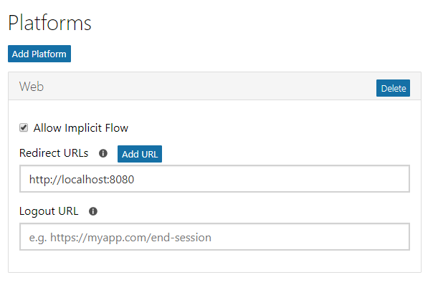
Application registration
Create a new application
Create a new application in the Application Registration Portal. A unique identifier is created for your app.
Add a web platform
Add a Web platform to your application registration. Enable the “Allow Implicit Flow” checkbox, and provide the redirect URL.

Slide 4

MSAL package installation
NPM:
NPM install MSAL
CDN:
https://secure.aadcdn.microsoftonline-p.com/lib/0.1.2/js/msal.min.js
Notes:
See https://github.com/AzureAD/microsoft-authentication-library-for-js for more information.
Note that msal.js is built for ES5, therefore enabling support of Internet Explorer 11. If you want to target Internet Explorer, you'll need to add a reference to promises polyfill. You might want to read more in the FAQ
<!-- IE support: add promises polyfill before msal.js --> <script src="https://cdnjs.cloudflare.com/ajax/libs/bluebird/3.3.4/bluebird.min.js" class="pre"></script> <script src="https://secure.aadcdn.microsoftonline-p.com/lib/0.1.1/js/msal.min.js"></script>

Slide 5
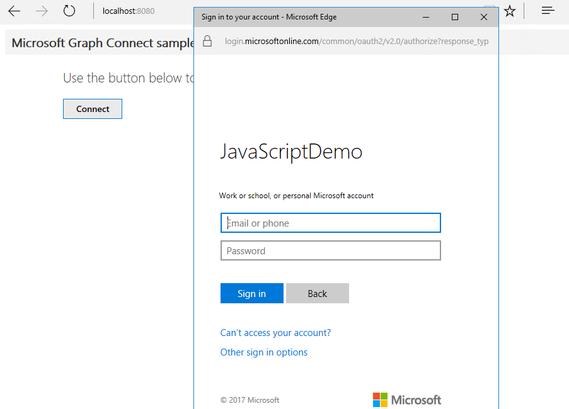
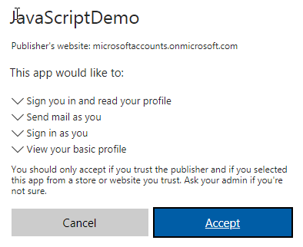
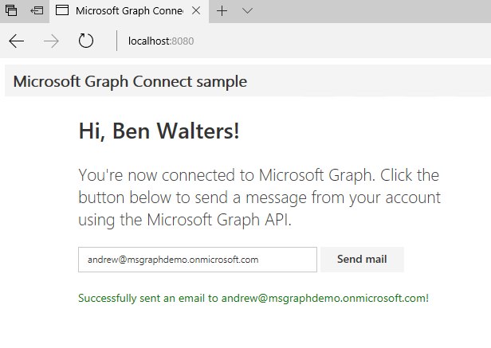
Application experience
User prompted to sign in
Navigate to http://localhost:8080 and click Connect, you are prompted to sign in.
Prompt for consent
The user is prompted to grant consent to the application if the admin has not granted consent for the entire tenant.
Data is returned
The Microsoft Graph API is queried and data is returned to the client. Clicking the button, an email is sent to the email address provided.

Slide 6


Overview of the sample
https://login.microsoftonline.com/
https://graph.microsoft.com
Sign in, get token
Teams
Groups
Access token
Tasks
Get my profile
Chats
Calendar
Files
My profile
Insights
Microsoft Graph
Messages
Send email
Coworkers
User
Meetings
Devices
People
Notes:
Not shown in this diagram, it is recommended for JavaScript apps using MSAL or ADAL libraries to first call its own endpoint, passing the id_token to validate the token is intended for the app instead of replaying a token from a man in the middle attack.

Slide 7
JavaScript applications – implicit grant and v2 endpoint
https://login.microsoftonline.com/common
Application
/common/OAuth/v2.0/authorize
https://graph.microsoft.com
?response_type=token&client_id=…
Sign in, consent
access_token
/v1.0/me (access token)
Current user’s profile
POST /v1.0/me/sendMail (access token)
HTTP 202
Notes:
This slide shows how the protocol works, and what the MSAL library simplifies for you.
JavaScript applications using the v2 endpoint work similarly to other types of applications, but use a flow type called “implicit flow”.
The call to /common/OAuth/v2.0/authorize will pop up a login screen and request permissions consent. Unlike using the previous section using a code grant, there is not a separate call to obtain a token. The access token is returned as part of the HTTP response in an HTML fragment.
The MSAL library handles the hidden sign-in request upon expiration, this is transparent to the user. Handled via a hidden iFrame renewal method, doesn’t use refresh tokens. Note that this can have implications on browser configuration such as trusted sites and zones and the requirement of enabling iFrames.
Not shown in this diagram, javascript apps secured via MSAL JS (or ADAL JS) should first call their own backend with the id_token to validate that the user actually obtained a token meant to the app, and they are not just replaying a token stolen from a man in the middle attack.

Slide 8
Demo

Slide 9
Scenarios where this is useful
Teams
Groups
1
Create an app that will automatically send status emails on behalf of the current user.
Integrate communications and operations processes to avoid forgetting important emails.
Extend JavaScript applications to work with the user’s OneDrive files.
Tasks
2
Chats
Calendar
Files
3
Insights
Microsoft Graph
Messages
And many more…
Coworkers
User
Meetings
People
Devices
Notes:
While this section refers to a very simple scenario, it’s not hard to imagine the new capabilities that you could add to an existing application or new scenarios. Using just JavaScript, you could build an application that gathers intelligence on individuals invited to a meeting such as the files they are working on, the groups they belong to, and people that are common to each of you.

Slide 10
Thank you.

